Slide 1
Discrepancy in Risky Decision Making of Insomniac Group and Correlated Neural Representations: A fNIRS Study
Presenter: Miao He, Wang Ruisi, Yuan Jingrui

Slide 2
Outline of Presentation
Background Introduction
Hypothesis
Methods
Data Analysis
Expected Results

Slide 3
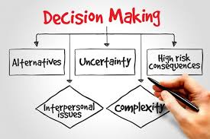

Introduction - Risky Decision - Making
Risky decision-making: Process of making choices involves uncertainty about outcomes and negative consequences.
Weight potential benefits against risks, considering additional factors (probability, magnitude, and likelihood of different outcomes)
Involve trade-offs between rewards and losses, gain against their aversion to loss.
Influenced by variety factors (personal traits, cognitive biases, emotional states, and situational contexts)
Notes:
Risky decision-making refers to the process of making choices that involve uncertainty about potential outcomes and the possibility of negative consequences.
In risky decision-making, individuals weigh the potential benefits of a decision against its potential risks, considering factors such as probability, magnitude, and likelihood of different outcomes.
Risky decisions often involve trade-offs between potential rewards and potential losses, and individuals may need to balance their desire for gain against their aversion to loss.
Risky decision-making is influenced by a variety of factors, including personal traits, cognitive biases, emotional states, and situational contexts.

Slide 4
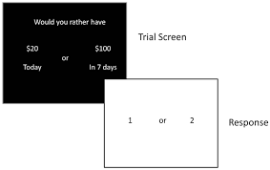
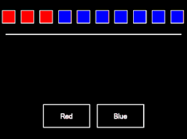
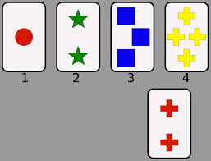
Risk-Taking Measurement Tasks
Delay Discounting Task (DDT) (Chung et al., 1967)
Binary choices between smaller-sooner and larger-later rewards, measures discount rewards.
Cambridge Gambling Task (CGT) (Rogers et al., 1999)
Bet on hidden tokens color with varying probabilities, incorporates real-time waiting and betting elements; assesses both impulsivity and response inhibition.
Wisconsin Card Sorting Task (WCST) (Kongs et al., 2000)
Sort cards based on shifting rules, assesses the ability to adapt to changes in rules without explicit feedback; measures perseveration errors.
CGT provides dynamic and immersive experiences that closely simulates real-world gambling scenarios, capturing both cognitive and emotional aspects of risk-taking.
Notes:
Variety of tasks focusing on risk decision making has been developed in recent 50 years, focusing on different cognitive aspects and dimensions.

Slide 5
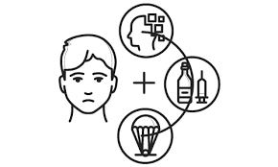

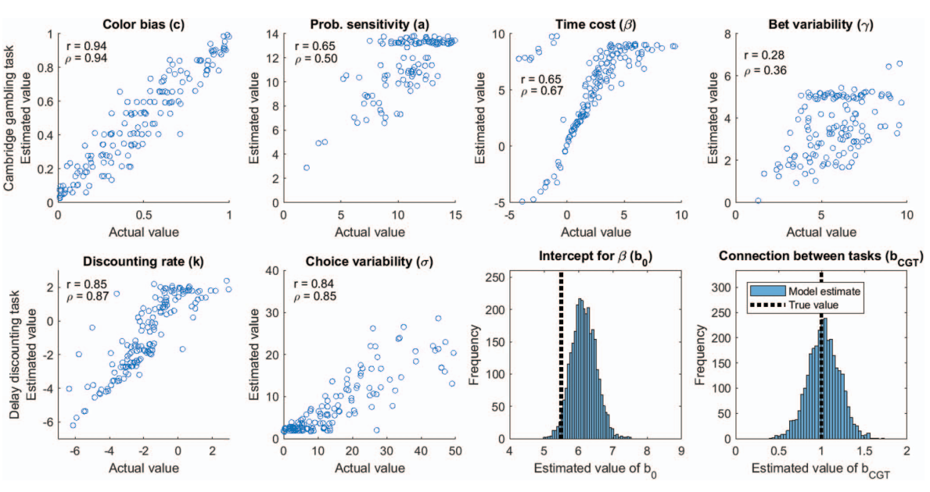
CGT - Behavioral Results
CGT and Psychosis (Woodrow et al., 2018)
Impairment in decision-making ability identified in individuals with psychosis.
Negative symptoms and IQ linked to decision-making, not positive symptoms.
CGT and Substance Use Disorders (Romeu et al., 2020)
Substance users exhibit impulsive decision-making, steeper delay discounting.
CGT parameters can discriminate between types of substance users.
However…
Lacks of evidence for those normal (not disordered) but have specific decision making trends group.
Kvam, P. D., Romeu, R. J., Turner, B. M., Vassileva, J., & Busemeyer, J. R. (2021). Testing the factor structure underlying behavior using joint cognitive models: Impulsivity in delay discounting and Cambridge gambling tasks. Psychological methods, 26(1), 18.
Notes:
CGT has been widely used in psychosis and disorder patients decision analysis.
However, it still lacks of evidence of the measures using Cambridge gambling tasks of those who have the specific patterns or trends of risky-decisions but not could be defined as a disorder people.

Slide 6
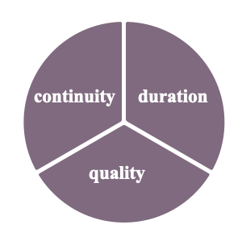
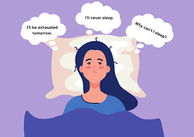
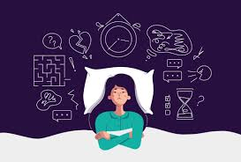
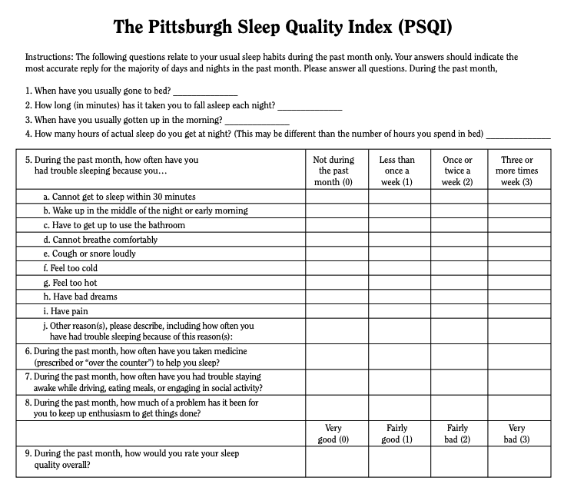
Introduction - Insomnia
Definition of Insomnia
Definition
Insomnia is a dissatisfaction with the quality, duration, or continuity of sleep.(Charles M,2022)
Prevalence
1/3 of adults report at least one insomnia symptom.(Morin CM,2006)
18.5% is the mean prevalence in college student population.(Jiang,2015)
Insomnia is a significant public health problem.
The Demo of PSQI
Evaluate Tools
Quantitative and validated scales:
PSQI (Pittzuihsburgh sleep quality index)
ISI (Insomnia severity index)
ESS (Epworth sleepiness scale)
Notes:
One of the specific group has specific decision trends is…

Slide 7
Introduction- Insomnia Impaired Cognitive Functions
Attention
Working
Memory
Concentration
It is the most extensively studied neurobehavioral domain.(Bronlow,2020)
Insomnia has a attentional bias towards sleep-related stimuli than good sleepers. (Harris,2015)
Meta review reported mild but not definitive working memory deficits.(Monteiro ,2016)
Majority of studies have reported on subjective complaints, and there is limited evidence on objective measure.
Decision Making
Notes:
Insomnia has several negative affects like…
For these affects, we could infers that Insomnia has a effect on decision making, especially for those decisions in short-term with uncertainty and risk.

Slide 8
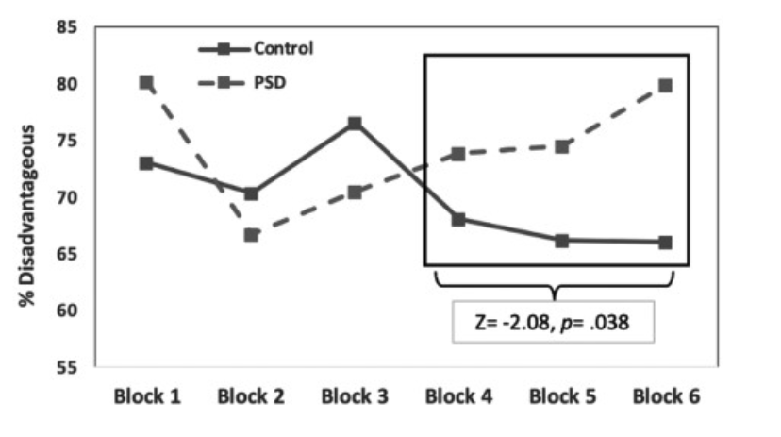
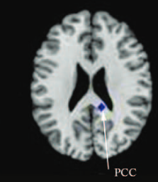
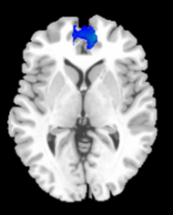
Insomnia and Risky Decision-making
Fig3.The Results of the IGT(Burnet,2020)
Sleep plays an important role in risk preference and decision-making.
Shorter sleep duration ,
Higher sleep need ,
Riskier decision-making.(Ying,2019)
The abnormal neural patterns in insomnia patients.
The activation patterns in decision making stages in Cambridge Gambling Task(CGT).
Fig6. The Results of ALE Method(Wu,2019)
FIg.7 The Result of ES-SDM Method (Jiang,2019)
FIg.4 The Color Decision stage in CGT
Fig.5The Bet Decision Stage in CGT
Frontal Lobe
(decision making, working memory)
PCC
(error detection, reward-based learning)
(Yazdi,2019)
Dorsolateral prefrontal cortex (Color decisions)
Frontal Pole (Bet Decisions)
Notes:
Here comes to the research results and evidences of insomnia affects risky decision making.
DLPFC: Decision Making, Working Memory, and Executive Function
Frontal Pole: Strategic planning, decision-making and behavioral choices
There is a overlap of brain regions in CGT and Insomnia group researches, however it still unclear how these overlap will occur by using the CGT with the Insomnia-Control group comparison.

Slide 9
Outline of Presentation
Background Introduction
Hypothesis
Methods
Data Analysis
Expected Results

Slide 10
Hypothesis
Main Hypothesis: Insomnia people will have a greater tendency to make risky decisions, with less activation of decision-related brain regions.
For Behavioral Hypothesis:
Hypothesis 1: Insomnia group will have overall worse performance in Cambridge Gambling Tasks
Hypothesis 2: Insomnia people will have slower reaction speed compared to control group.
Hypothesis 3: Insomnia people will have higher risk- taking trends compared to control group.
For Neural hypothesis:
Hypothesis 4: The prefrontal cortex will be less activated in insomnia group compared to control group
Notes:
The main hypothesis is…
In behavioral level…
For the neural results, we hypothesized that…
We will explain further in expected results part with main variables.

Slide 11
Outline of Presentation
Background Introduction
Hypothesis
Methods
Data Analysis
Expected Results

Slide 12
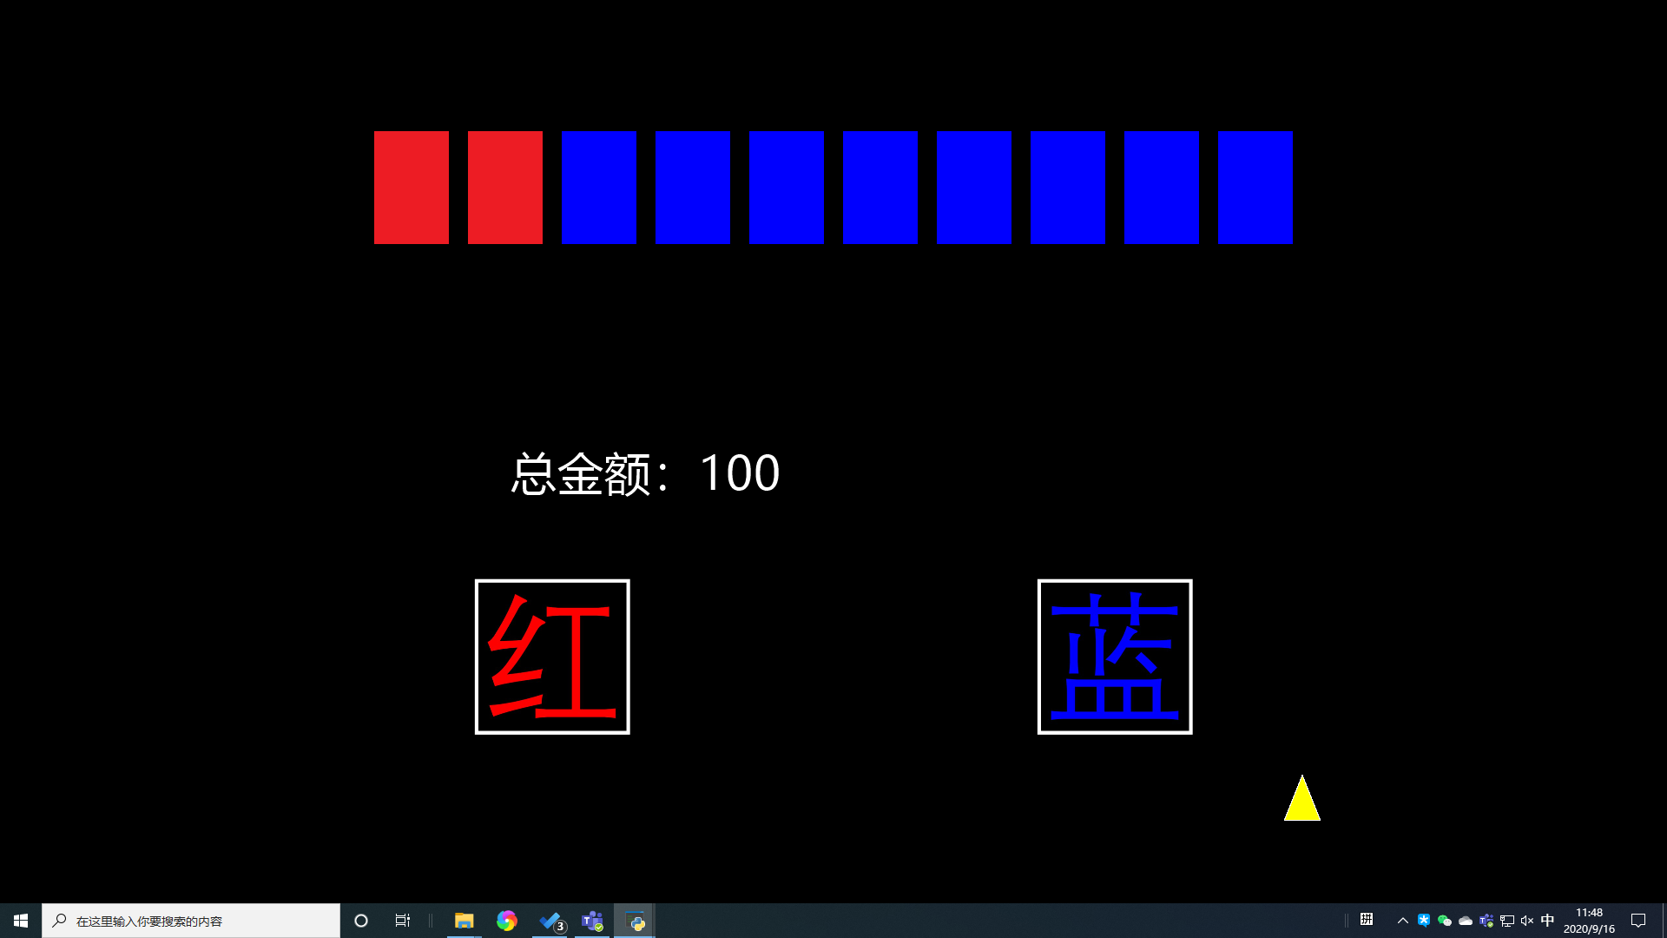
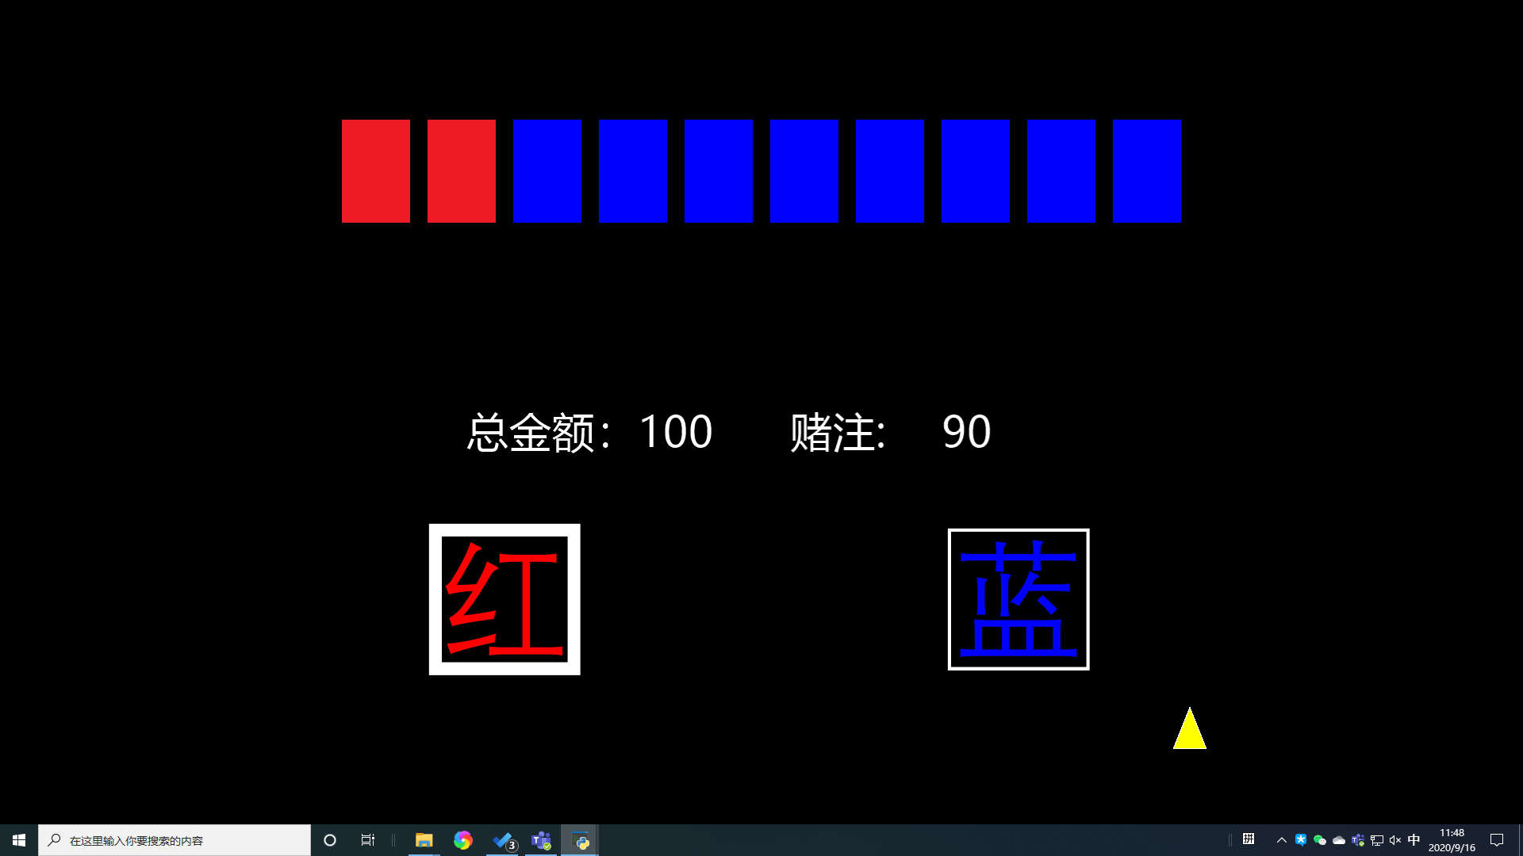
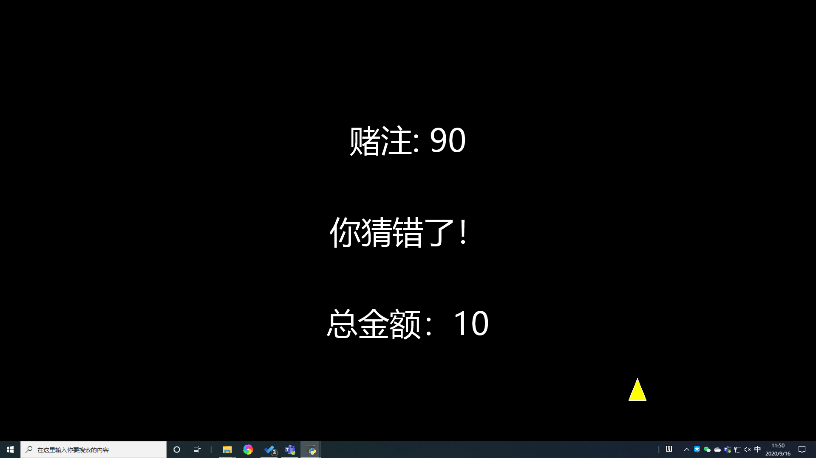
Method- Paradigm
Main 3 Phases
Color Decision Phase: Choose the bet color
Bet Decision Phase: Choose the bet time (With varing bet amount)
Outcome Phase: Show the bet results
Color Decision Phase
Bet Decision Phase
Bets amount vary from small to large or from large to small (95%, 75%, 50%, 25%, 5%).
Correct Choice: Receive the amount when bet
Incorrect Choice : Lost the amount when bet
Outcome Phase
Notes:
There are 3 main phases in CGT. First is the color decision phase, there are two colors, red and blue cards with total 10 cards will be shown in each trial. The change of each color is from 1 to 9. Reward will occurs in one of color. Probability distribution of reward follows the card color distribution as each trial shows. click left/right button to choose in color decision phase. When finish choosing the bet color, it comes to bet decision phase. The bets vary from small to large and from large to small (the ratio is 95%, 75%, 50%, 25%, 5% of the total bonus) and are presented randomly. Put the Down button when they want to bet at that bet amount. After betting, finally comes to the outcome phase. If the subject guesses correctly, they will receive the corresponding amount; If the subject guesses wrong, the corresponding amount will be lost.

Slide 13
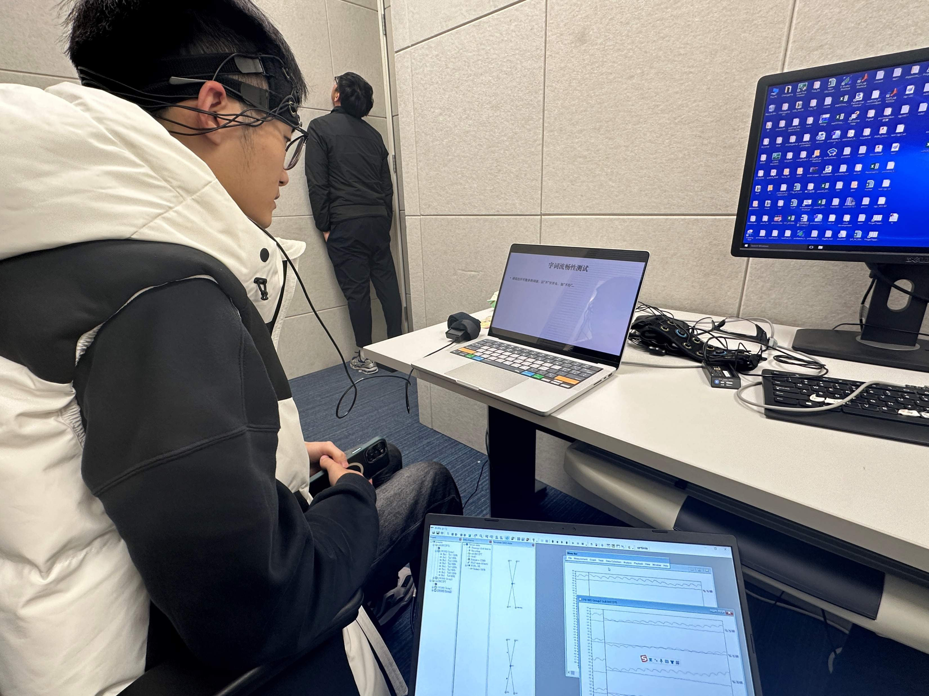
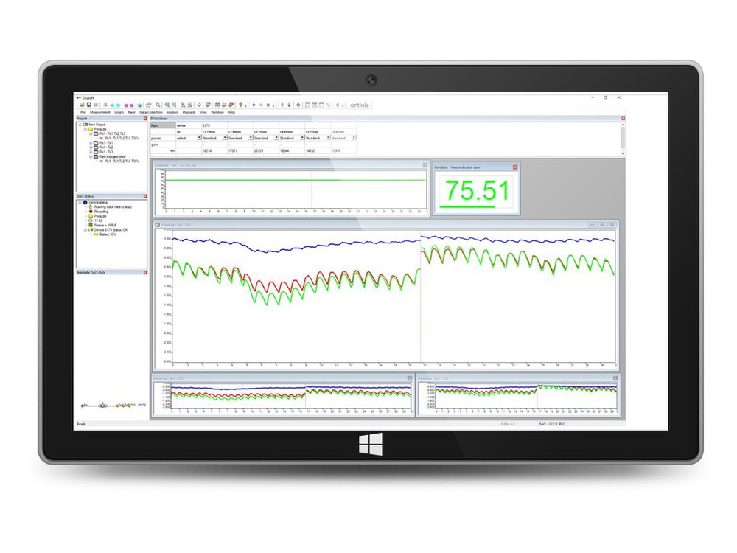
Method – fNIRS
Hareware : Artinis OxyMon 8channel: 8 - Channel fNIRS, scanning for the prefrontal cortex
Software: OxySoft: Displays relative concentration changes in oxy-, deoxy-, total hemoglobin, and tissue saturation index (TSI) in real-time.

Slide 14

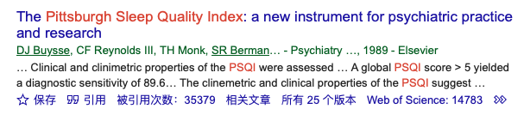
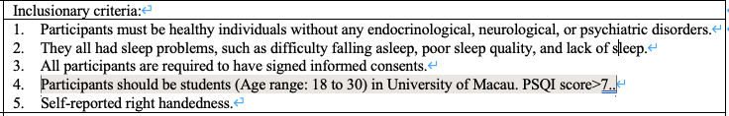
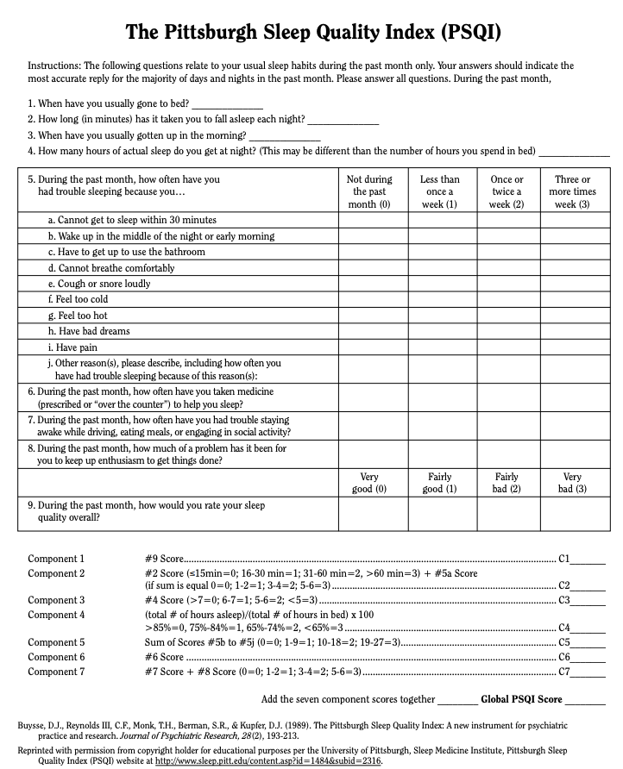
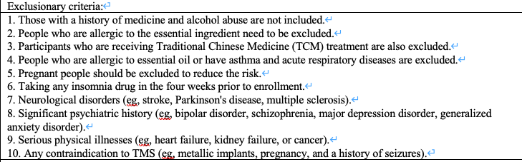
Method – Scales
Quality
(Buysse,1989)
Latency
Efficiency
Duration
7 sub-scales
Medication
Disturbances
Dysfunction
(Liu,2021)
https://www.psychdb.com/_media/sleep/2-insomnia-disorder/the_pittsburgh_sleep_quality_index_psqi.pdf
Notes:
When it comes to how we recruited insomnia subjects and the inclusion criteria, we chose the PSQI scale.The PSQI is a self-report questionnaire that assesses sleep quality over a 1-month .As we can see from the firgure on the left, it is divided into seven components related to sleep quality.And there is a demo of PSQI ,It consists of 19 individual items and takes 5–10 minutes to complete.The reason we choose to use it to measure insomnia symptoms is it is the most widely use tools due to our literature review ,we can see it from its citations over 35000.And there are our inclusion and exclusion standards.

Slide 15
Outline of Presentation
Background Introduction
Hypothesis
Methods
Data Analysis
Expected Results

Slide 16
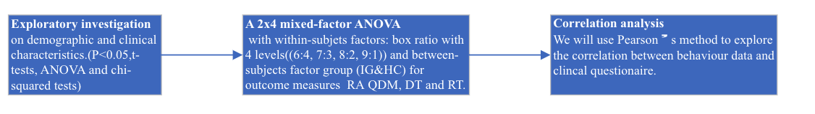
Analysis & Expected Results – Behavioral Analysis
Variables to test:
Hypothesis 1: Insomnia group will have overall worse performance in Cambridge Gambling Tasks
(QDM,quality of decision making): The total number of rational choices
Hypothesis 2: Insomnia people will have slower reaction speed compared to control group.
(DT,delibration time):The mean reation time.
Hypothesis 3: Insomnia people will have higher risk- taking trends compared to control group.
(RT,risk taking):The average bet.
(RA,risk adjustment):The average bet differ relative to box ratio.
Statistical Methods:
Notes:
Thanks Ray , Let me followed by analysis and results part. First is behavioral data. Though Cambridge gambling task has various parameters to reflect faces of decision-making ,we highly focus on risky decisions, so we choose four dependent variables. Correspond to hypothesis one , insomnia group will have overall worse performance , we will use QDM ,quality of decision making to measure overall performance, it means the total number of rational choices ,specifically, the rational choices means you choose the majority color. In this screenshot , if u choose blue ,it is a rational choice. Hypothesis two, insomnia have slower speed, so we use deliberation time basically just RT to measure .Hypothesis three, insomnia will have higher risky preference. We will use two variables to measure, first is risk taking ,means the average bet ,the bet is higher ,risk preference is higher.Risk adjustment means the average bet differ to box ratio . It will be explained with more details in next page.Our statistical protocol will follow this flowchart.After exploratory investigation , we will use a 2 times 4 mixed factor anova to test our 4 variables. The within-subjects factors is box ratio ,and the between-subjects factors is group.Then we will do correlation analysis, to explore the relationship between behavioral data and clinical questionnaire.

Slide 17
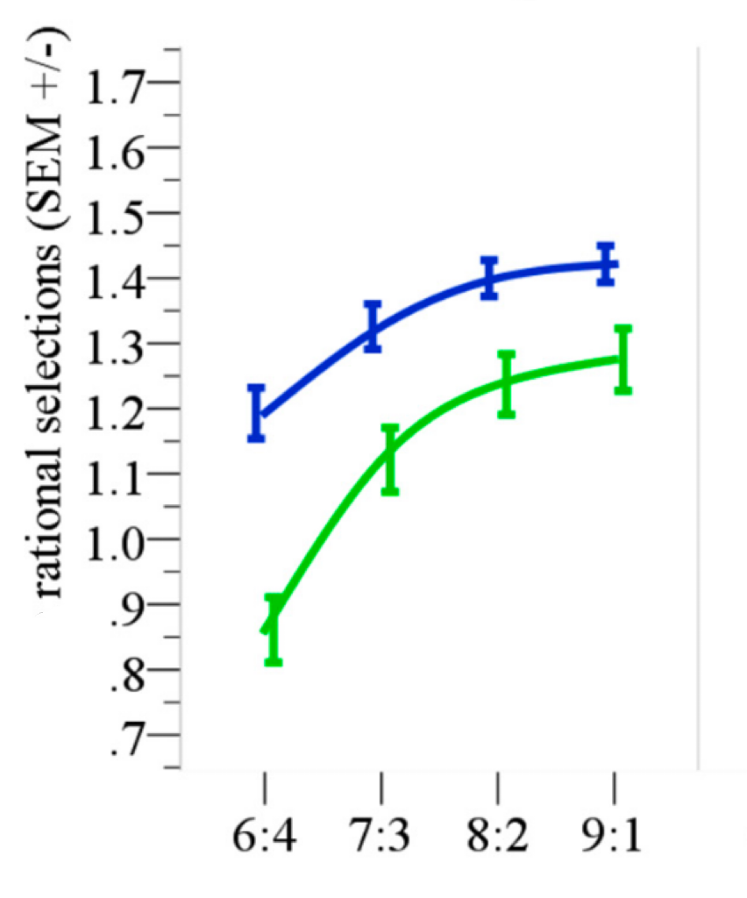

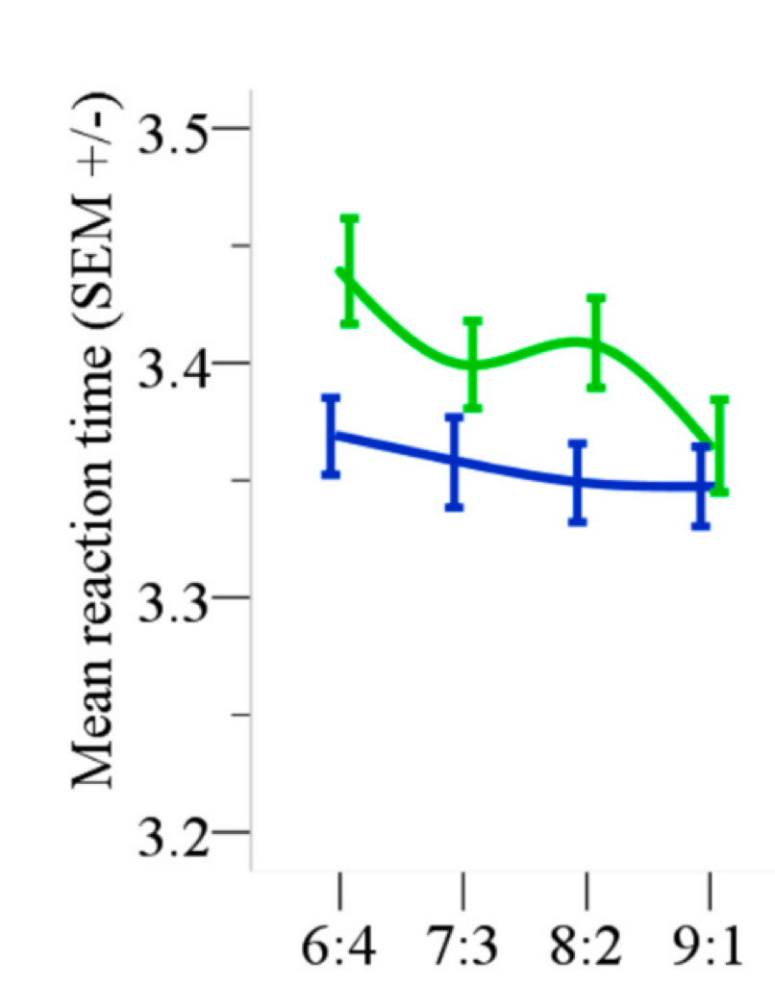
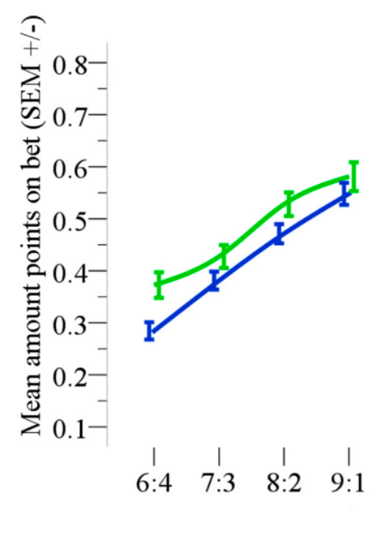
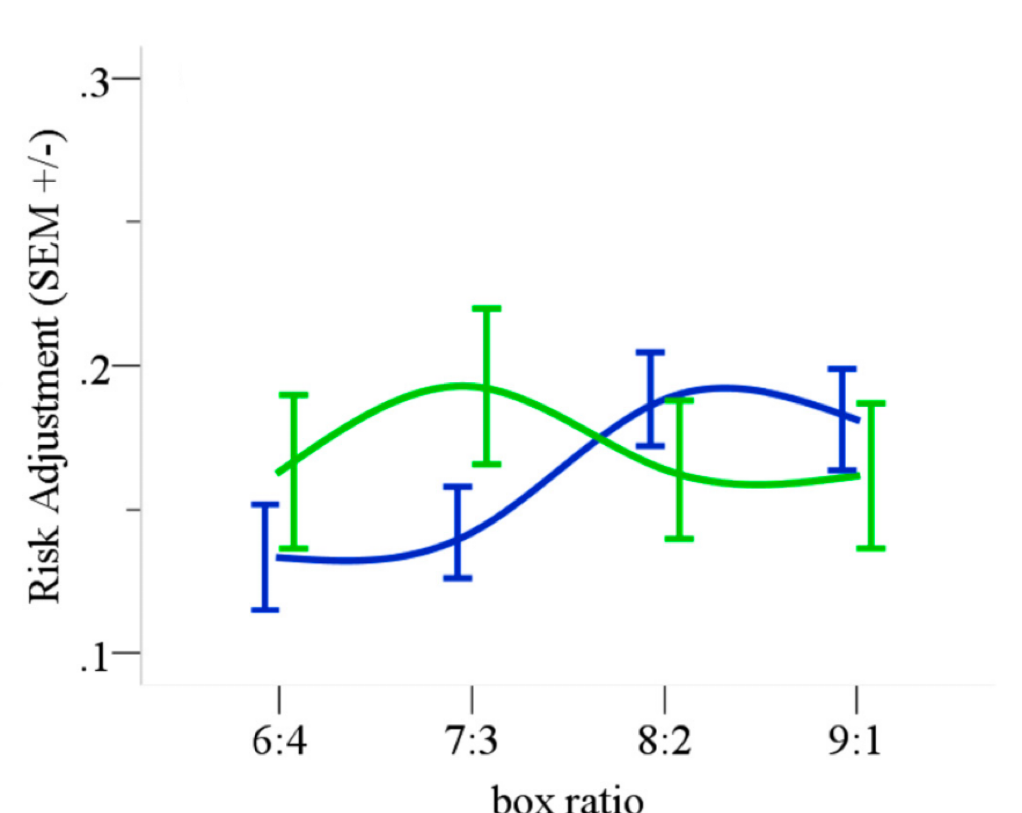
Analysis & Expected Results – Expected Results
Behavioral Expected Results
Expected Results 1: The total number of rational choices, Insomnia group will be lower compared to control group.
Expected Results 2: The mean reaction time of Insomnia group will be longer than the control group except in condition boxratio 9 :1.
Expected Results 3: The averaged bet is higher in insomnia group compared to control group.
Expected Results 4: The risk adjustment in insomnia group is different to controls.
HC
IP
Notes:
Speaking of our expected results, we also find some prototype demos .First ,insomnia group has less rational choices than control.Second, the mean reaction time will be longer than control expect the box ratio is over domain like in condition 9 to 1.Third, the averaged bet is higher in insomnia group ,means they are more likely to make risky choices than controls.Last ,there might be a interaction in risk adjustment reflects that insomnia group won’t make rational choices with different box ratio.

Slide 18
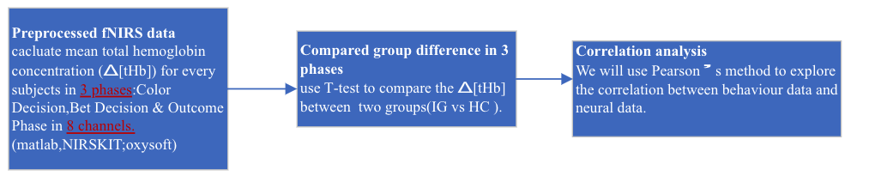
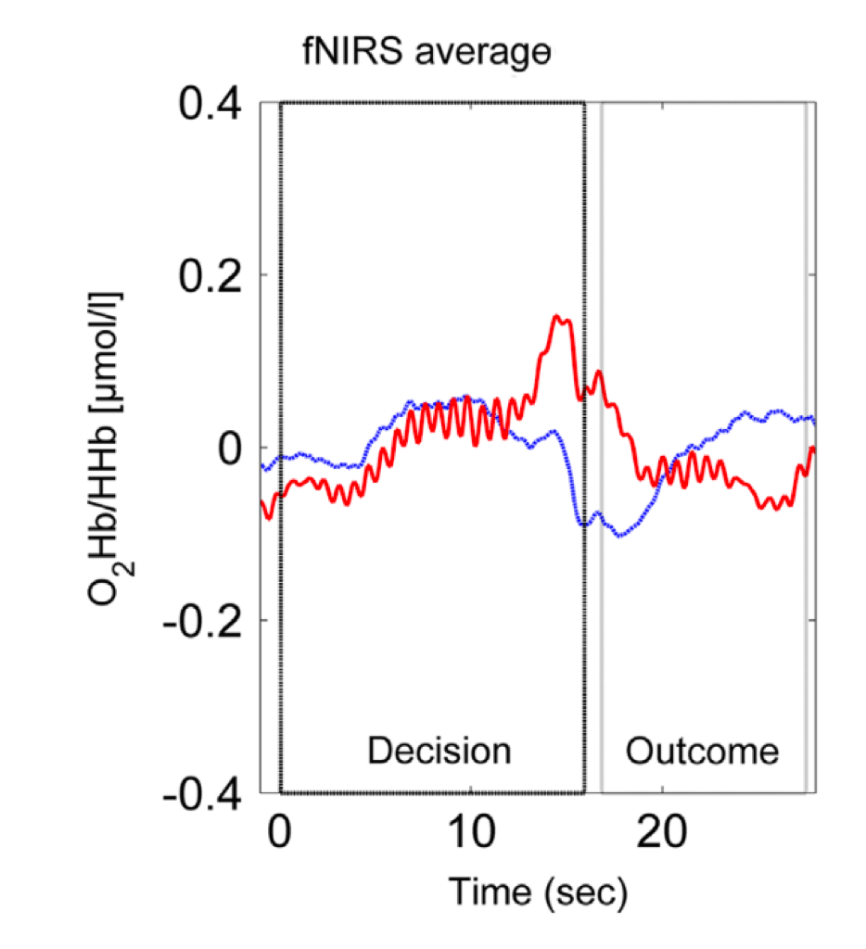
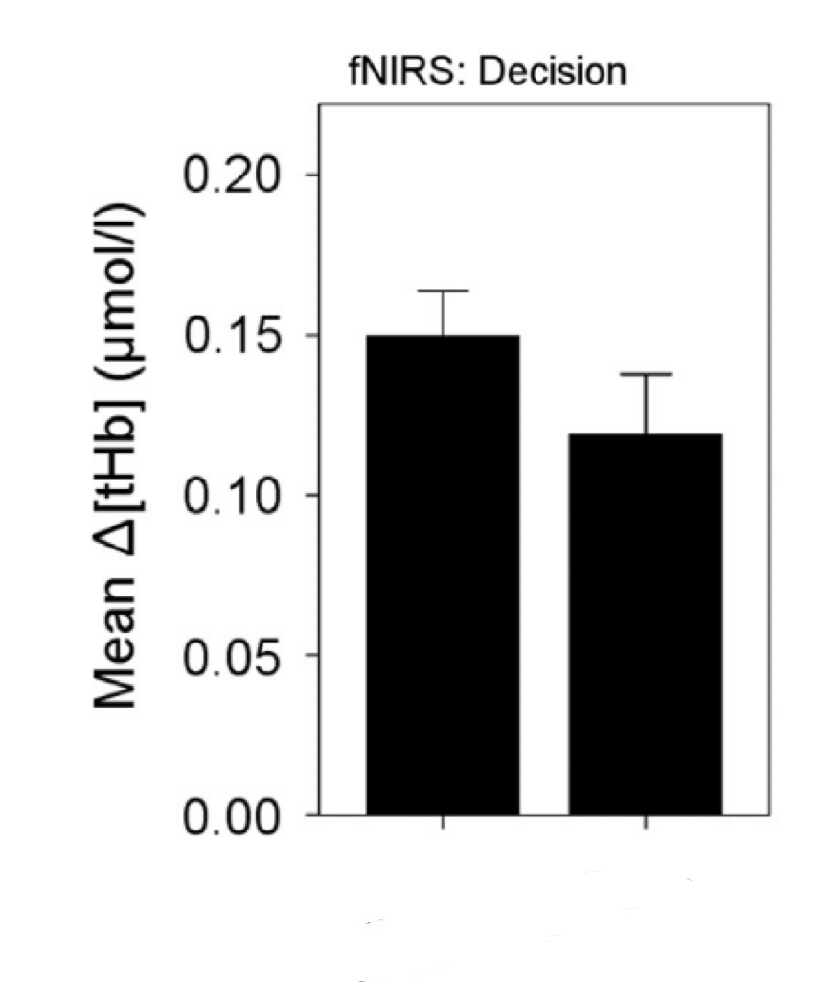
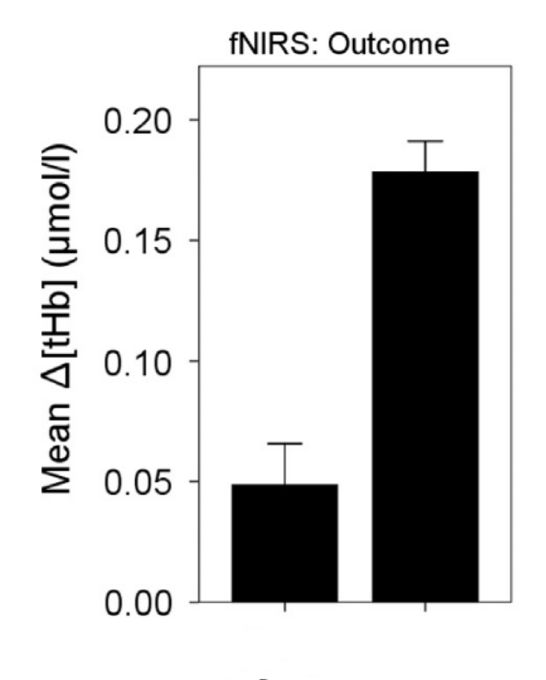
Analysis & Expected Results – fNIRS Analysis
Hypothesis 4: The prefrontal cortex will be less activated in insomnia group compared to control group
HC IG
IG HC
Notes:
In terms of fNIRS analysis and results, connecting to our hypothesis, the prefrontal cortex will be less activated in insomnia group .So will use the mean total hemoglobin concentration to measure.We can see from our work flow ,first is preprocessed fNIRS data ,we will use oxysoft and NIRSKIT based in Matlab .And we will calculate mean total hemoglobin in three phases.Then we will do some t-tests to compare the amount of tHB concentration during three stages.Just like two figures on right, the mean tHB of health controls will be higher than insomnia group in decision stages. To be honest ,we are still not sure about outcome stage, but we are very curious about the results ,as it there are some literature showed that Impaired error learning in patients with severe insomnia but due to limitations of fNIRS we cannot see PCC directly , so the changes in prefrontal cortex in outcomes stages remains sure.After that ,we will do some correlation analysis too.Similarly , we will use some prototype figures to explain our expectations. The first figure illustrates the averaged time courses of fNIRS prefrontal cortex hemodynamic signals in two groups. We believe because of lack of sleep and daytime dysfunction, the insomnia group will have less prefrontal activities in decision making stages , and that is the neural representation for their worse overall decision-making performance.

Slide 19
Outline of Presentation
Background Introduction
Hypothesis
Methods
Data Analysis
Expected Results

Slide 20
Analysis & Expected Results – Expected Results
Correspondence With the Hypothesis –
Behavioral Expected Results
Expected Results 1: The mean value of final token gotten by Insomnia group will be lower compared to control group.
Expected Results 2: The mean reaction time of Insomnia group in both color decision and bet decision phase is longer than the control group
Expected Results 3: The averaged propotion of token amount bet in each trial is higher in insomnia group compared to control group.
Neural Expected Results
Expected Results 4: The activation in Frontal Pole and DLPFC in bet decision phase is lower in insomnia group compared to control group.

Slide 21
Timelines of Project
3.22-4.2
4.2-4.7
4.8-4.15
4.15-4.22
4.22-4.29
Theoretical framework and research questions determination
Experimental paradigm modification and brain imaging method
completion
Preparing for presentation & debugging equipment, pilot data collection
Project presentation, oral data collection & analysis
Preparation for final presentation

Slide 22
Thanks for Listening
Q&A
Presenter: Miao He, Wang Ruisi, Yuan Jingrui

